Slide 1
06. ປ່າໄມ້ປຽບເໜືອນທືນ
Country | Laos
Language | ■ English ■ Local Language
Course Title | Forest Resource Economics
Lesson Title | 06. Forest as capital
SME | Somvang Phimmavong, PhD
Submission Date | September 26, 2014
Version | 01
Storyboard

Slide 2
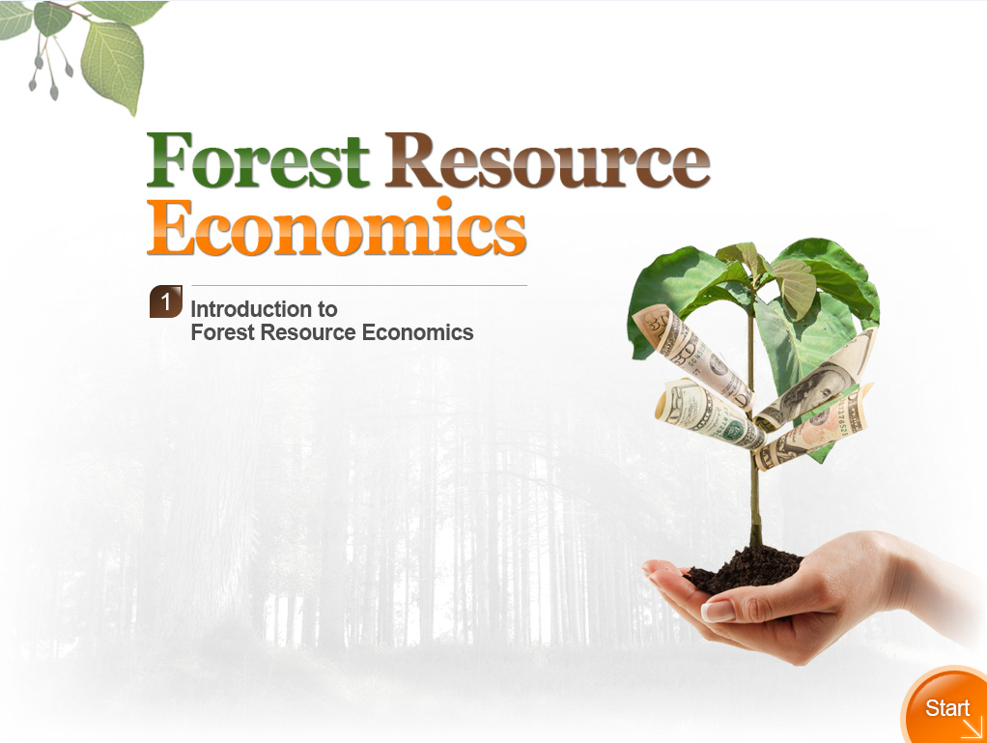
Supply
03
ປ່າໄມ້ປຽບເໜືອນທືນ
06
Storyboard

Slide 3
ພາບລວມ
Consider the forest as a store of wealth, or capital.
How we can allocate these in a way that maximizes satisfaction to society
How to use standard tools of financial analysis to evaluate forestry decisions
Notes:
#2 Hallo everyone! Welcome to the class of forest resource economics. The previous chapters tell us the nature of market structure and different marketing strategies.
#3In this chapter, we will firstly consider the forest as a store of wealth, or capital. In a financial sense, if we consider trees and land as capital, two of the most important inputs into forestry are capital and time. #4We will see how we can allocate these in a way that maximizes satisfaction to society? #5We will learn how to use standard tools of financial analysis to evaluate forestry decisions-to decide how much to pay for forest properties and management practices and calculate how profitable forest investment are.

Slide 4
ສັບວິຊາການ
ອັດຕາຜົນຕອບແທນຂັ້ນຕໍ່າ ຊື່ງຜູ້ຕັດສີນໃຈ ຕ້ອງການຕໍ່ຕົ້ນທືນ, ຊື່ງຖືກນຳໃຊ້ສຳລັບອັດຕາດອກເບ້ຍຂອງນັກລົງທືນ. ຊື່ງບາງຄົ້ນກໍ່ຮຽກວ່າອັດຕາຕອບແທນຈູງໃຈຂັ້ນຕໍ່າ
ອັດຕາດອກເບ້ຍທີ່ນຳໃຊ້ໃນການຄຳນວນມູນຄ່າອະນາຄົດມາເປັນ ຄ່າປະຈຸບັນ
ອັດຕາຕອບແທນຕໍ່ການລົງທືນເພື່ອການຜະລິດເປັນສີນຄ້າ ແລະ ການບໍລິການ
K
E
Y
W
O
R
D
ອັດຕາຜົນຕອບແທນຍອມຮັບຂັ້ນຕໍ່າ(MAR)
ອັດຕາດອກເບ້ຍ
ອັດຕາຜົນຕອບແທນ
Notes:
#2 Here there are some keywords are provided, Please drag a keyword and drop to the best place

Slide 5
03_01
ຈຸດປະສົງ
Learner can understand the basic theory of capital and interest
Learner are able to calculate present and net present value of a project
Learners are able to apply economic tool for the analysis of the government policy and investment project
Learner can solve a case example of investment appraisal of a forestry plantation
Notes:
#2 After finishing this lesson, learners are expected to achieve the following objectives
1. #3 Learner can understand the basic theory of capital and interest
2. #4 Learner are able to calculate present and net present value of a project
3. #5 Learners are able to apply economic tool for the analysis of the government policy and investment project
4. #6 Learner can solve a case example of investment appraisal of a forestry plantation

Slide 6
03_01
ຫົວຂໍ້
1. ທືນ ແລະ ດອກເບ້ຍ
ມູນຄ່າປະຈຸບັນ ແລະ ປະຈຸບັນສຸດທິ
3. ຕົວຊີ້ວັດການລົງທືນ
ກໍລະນີສຶກສາ ການວິເຄາະການລົງທືນສວນປູກ
Notes:
#2 There are 4 topics in this lesson:
#3 First, I will present about capital and interest
#4 Second, I will elaborate on present and Net present value
#5 Then, investment Criteria will be discussed
#6Finally, learners will learn about Case example of investment appraisal of a forestry plantation

Slide 7
ຄຳຖາມທົດສອບ
ຈົ່ງເລືອກປັດໃຈການຜະລິດ ສອງ ປັດໃຈຕົ້ນຕໍ້ໃນການລົງທືນປ່າໄມ້ ກໍລະນີພວກເຮົາພິຈາລະນາ ຕົ້ນໄມ້ ແລະ ທີດີນປຽບເໝືອນທືນ ໃນແງ່ການເງີນ
ປຸ້ຍ ແລະ ແຮງງານ
1
ຄ່າເຊົ່າ ແລະ ໂຮງງານ
2
ທືນ ແລະ ເວລາ
3
ບໍ່ແມ່ນທັງໝົດ
4
Notes:
#2 Let’s do the quick pre-test about your experience! Please choose the only one right answer!
Answer: 3
Commentary: If we consider trees and land as capital, two of the most important input in forestry are capital and time. This is because forestry investment needs tree and land to be established. Furthermore, trees take so many years in order to be ready for harvesting which is unlike agricultural crops.

Slide 8
01: ທືນແລະດອກເບ້ຍ
ພາກສະເໜີ
Compounding interest
Notes:
#2 Topic01: Capital and interest

Slide 9


1. ທືນ ແລະ ດອກເບ້ຍ
1
ພາກສະເໜີ
The classical economic theory
Capital was defined as durable goods produced by human
and used in production.
  Durable goods such machinery, equipment, tools, works of art, and building, inventories of goods
  Financial assets such as saving accounts bonds, stocks, and certificates of deposit
  Land and natural resources such as coal, oil, and timber
Similarities, they are all assets that can be bought and sold.
Forest enterprise who invest in forest management expect to get more than they gave up for it.
Notes:
#2 The classical economic theory defines capital as durable goods produced by human and used in production. Broadly speaking, three types of capital assets can be classified:
#4Durable goods such as machinery, equipment, tools, works of art, and building, inventories of goods
#5Financial assets such as saving accounts bonds, stocks, and certificates of deposit
#6Land and natural resources such as coal, oil, and timber
#7By looking at their similarities, they are all assets that can be bought and sold. If you buy an asset, you give up the chance to spend that money now on goods and services.

Slide 10
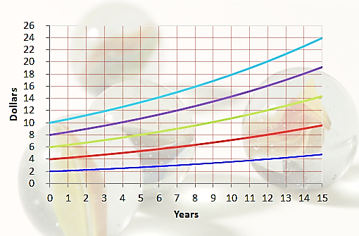
1. ທືນ ແລະ ດອກເບ້ຍ
2
Compounding interest
ຮູບສະແດງໃຫ້ເຫັນ
V_{n}=10(1+0.06)^{n}
V_{n}=8(1+0.06)^{n}
The capital growing at the compound interest rate without any income withdraw
V_{n}=6(1+0.06)^{n}
V_{n}=4(1+0.06)^{n}
V_{n}=2(1+0.06)^{n}
ການຄິດໄລ່
ເພື່ອຄິດໄລ່ມູນຄ່າອະນາຄົດ V_{n} ຈາກມູນຄ່າການລົງທືນເບື້ອງຕົ້ນ V_{o}, ພວກເຮົາສາມາດນຳໃຊ້ສູດດັ່ງຕໍ່ໄປນີ້:
ຮູບທີ 6.1: ກໍລະນີ ດອກເບ້ຍ 6 ເປີເຊັນ
V_{n}=V₀(1+r)^{n}
(6.1)
Notes:
#2 Compounding interest
#3Figure 6.1 shows the capital growing at the compound interest rate without any income withdraw. Suppose, the interest rate of bank is 6 percent p.a and vertical axis shows the value in dollar term. #4To compute any future value Vn from an initial investment of V_{o}, the following formula 6.1 is used

Slide 11
1. ທືນ ແລະ ດອກເບ້ຍ
2
Compounding interest
ຕົວຢ່າງ
ຖ້າພວກເຮົານຳເອົາ $2 ຫຼື $10 ໄປຝາກທະນາຄານ ໃນອັດຕາດອກເບ້ຍ 6%. ອີກ 15 ປີຕໍ່ມາ n=15 ພວກເຮົາຈະມີມູນຄ່າອະນາຄົດດັ່ງນີ້.
V_{n}=10(1+0.06)^{n}
V_{n}=8(1+0.06)^{n}
V_{n}=6(1+0.06)^{n}
V_{n}=4(1+0.06)^{n}
V_{n}=2(1+0.06)^{n}
ຄິດໄລ່ມູນຄ່າອະນາຄົດ (V_{n})
V₀ | r | n | V_{n}=V₀(1+0.06)^{n} ($)
2 | 6%=0.06 | 15 | 4.79
10 | 6%=0.06 | 15 | 24
ຮູບທີ 6.2: ກໍລະນີ ດອກເບ້ຍ 6 ເປີເຊັນ
Notes:
#3~1 For instance, if we put $2 dollar in the bank at year 0 at 6 percent interest, it will grow V_{n}=2(1.06)¹⁵= $4.79 in n= 15 years as shown in figure 1.2. So at 6 percent interest, you will more than double your money in 15 years.
#3~2 Likewise, if we put $10 dollar in the bank at year 0 at 6 percent interest, it will grow V_{n}=10(1.06)¹⁵= $24 in n= 15 years. So at 6 percent interest, you will more than double your money in 15 years.

Slide 12
02: ມູນຄ່າປະຈຸບັນ ແລະ ປະຈຸບັນສຸດທິ
ມູນຄ່າປະຈຸບັນ (Present value)
ມູນຄ່າປະຈຸບັນສຸທິ (Net present value)

Slide 13
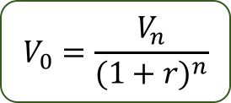

ມູນຄ່າປະຈຸບັນ ແລະ ປະຈຸບັນສຸດທິ
1
ມູນຄ່າປະຈຸບັນ
ຈາກສົມຜົນທີ 6.1, V_{n}=V₀(1+r)^{n} , ຖອນ V₀, ມູນຄ່າປະຈຸບັນຂອງການລົງທືນໃດໜື່ງດັ່ງນີ້:
1
$$V_{n}=V_{0}{(1+r)}^{n}$$
$$V_{0}=\frac{V_{n}}{{(1+r)}^{n}}$$
Notes:
#2 Present and Net present value
#2 Present value
#3 From equation 6.1, V_{n}=V₀(1+r)^{n} , we can solve to V0, the present value of any single value as equation 6.2

Slide 14


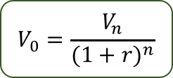
ມູນຄ່າປະຈຸບັນ ແລະ ປະຈຸບັນສຸດທິ
1
ມູນຄ່າປະຈຸບັນ
ຕົວຢ່າງ
ໃນອັດຕາດອກເບ້ຍ 6 ເປີເຊັນ, ມູນຄ່າ $1,000 ທີ່ຄ່າຫວັງອີກ 15 ປີມີມູນຄ່າປະຈຸບັນດັ່ງນີ້:໊
$$V_{0}=\frac{V_{n}}{{(1+r)}^{n}}$$
$V_{0}=\frac{1,000}{{(1+0.06)}^{15}}$= 417
$V_{0}≈\$$417
ນີ້ກໍໝາຍຄວາມວ່າ ຖ້າພວກເຮົາຕ້ອງການລາຍຮັບ 6 ເປີເຊັນ, ມູນຄ່າທີ່ຄາດໄວ້ $1,000 ອີິກ 15 ປີ ແມ່ນມິມູນຄ່າ ສູງສຸດ $417 ໃນມື້ນີ້ (ປະຈຸບັນ).
If we spend more than $417 to get $1000 in 15 years, the investment will grow at an unacceptable rate (less than 6%)
“ດັ່ງນັ້ນ, ດອກເບ້ຍທີ່ນຳໃຊ້ໃນການຄິດໄລ່ນີ້ ຖືກຮຽກວ່າ ” ອັດຕາຜົນຕອບແທນຍອມຮັບຂັ້ນຕໍ່າ (MAR).”
Notes:
#3 For instance, at interest rate of 6 percent, the value of $1000 expected in 15 years has a present value of 1000/1.06¹⁵=$417. and this imply that if we need to earn 6 percent interest, the promise of $1000 in 15 year is worth a maximum of $417 today.
If we spend more than $417 to get $1000 in 15 years, the investment will grow at an unacceptable rate (less than 6%). That’s why the interest rate used to calculate present values and future value will be called” minimum acceptable rate of return (MAR).

Slide 15
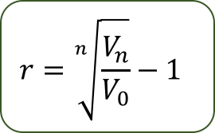


ມູນຄ່າປະຈຸບັນ ແລະ ປະຈຸບັນສຸດທິ
1
ມູນຄ່າປະຈຸບັນ
ຈາກສົມຜົນ 6.1 to ຖອນ r, ອັດຕາຜົນຕອບແທນ:
2
$$r=\sqrt[n]{\frac{V_{n}}{V_{0}}}−1$$
$$V_{n}=V_{0}{(1+r)}^{n}$$
${(1+r)}^{n}$= $\frac{V_{n}}{V_{0}}$
6.3
Notes:
#3 To get interest rate or the average annual rate of return, we can solve equation 6.1 to get “r” as it is expressed in equation 6.3. This r is usually called the internal rate of return.

Slide 16
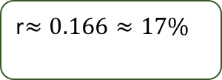
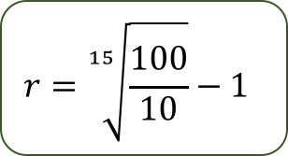

ມູນຄ່າປະຈຸບັນ ແລະ ປະຈຸບັນສຸດທິ
1
ມູນຄ່າປະຈຸບັນ
ຕົວຢ່າງ
ຊາວນາຜູ້ໜື່ງເປັນເຈົ້າຂອງຕົ້ນໄມ້ອາຍຸ 15 ປີ ຊື່ງມີມູນຄ່າ ເທົ່າກັບ $100 ແລະ ມູນຄ່າປະຈຸບັນຂອງຕົ້ນໄມ້ດັ່ງກ່າວເທົ່າກັບ $10
$$r=\sqrt[n]{\frac{V_{n}}{V_{0}}}−1$$
$$r=\sqrt[15]{\frac{100}{10}}−1$$
r$≈0.166≈17\%$
ສູດດັ່ງກ່າວນີ້ ຖືກນຳໃຊ້ເພື່ອຄິດໄລ່ ສະເພາະການລົງທືນແບບງ່າຍດ່າຍ ຊື່ງປະກອບມີປັດໃຈການຜະລິດ ແລະ ຜົນຜະລິດໜື່ງອັນ ຕົວຢ່າງ:
stocks
real estate
ຊື່ງຖືກຊື້ໃນມື້ດຽວ ແລະ ຈະຖືກຂາຍ ໃນປີຕໍ່ໆມາໃນອະນາຄົດ
ໄມ້ທ່ອນ
Notes:
#3 For example: A farmer owned a 15 years old tree with a value of $100 and the present value of this tree is $10. #4 Using 6.3, taking the 15th root of 100/10 and subtract 1 gives 0.16, the 16 percent interest rate.
#5 This formula is useful when calculating performance of simple investment with one input and one output #6 such as stocks, real estate, or timber #7 that is bought at one date and will be sold some years later.

Slide 17



ມູນຄ່າປະຈຸບັນ ແລະ ປະຈຸບັນສຸດທິ
2
ມູນຄ່າປະຈຸບັນສຸທິ
ມູນຄ່າປະຈຸບັນສຸທິ (NPV)
the present value of net cash flows
discounted by firm’s required return
#3
#4
$$ມູນຄ່າປະຈຸບັນສຸທິ \left(NPV\right)$$
$ມູນຄ່າປະຈຸບັນ$ຂອງລາຍຮັບ
$$\text{ມູນຄ່າປະຈຸບັນຂອງລາຍຈ່າຍ}$$
#5
ຖ້າ NPV ມີຄ່າບວກ, ຕອບຮັບໂຄງການ ຫຼື ໂຄງການມີກຳໄລ
ຖ້າ NPV ມີຄ່າລົບ, ໂຄງການບໍ່ມີກຳໄລ
Notes:
#3 NPV is the present value of net cash flows, discounted by firm’s required return #4 or it is the present value of revenues minus the present value of costs. #5 If the NPV is positive, accept the project and if the NPV is negative, reject the project.

Slide 18
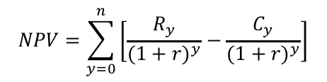

ມູນຄ່າປະຈຸບັນ ແລະ ປະຈຸບັນສຸດທິ
2
ມູນຄ່າປະຈຸບັນສຸທິ
$$ສູດ:$$
$$NPV=\sum_{y=0}^{n}{\left[\frac{R_{y}}{{(1+r)}^{y}}−\frac{C_{y}}{{(1+r)}^{y}}\right]}$$
6.4
“NPV ໝາຍເຖີງ ຄວາມເພີ່ງພໍໃຈຂອງນັກລົງທືນທີ່ພ້ອມຈະຈ່າຍ ຕໍ່ການລົງທ່ືນ (asset) ໂດຍອີງຕາມ ຜົນໄດ້ຮັບ, ລາຍຈ່າຍທີ່ຄາດໄວ້ ແລະ ອັດຕາຜົນຕອບແທນທີ່ຍອມຮັບໄດ້.”
Notes:
#3 Mathematically, NPV is the sum of revenues in each, y, discounted to year 0 minus the sum of costs in each year discounted to year 0. The difference between this equation and equation 6.2 is that this equation include negative as well as positive cash flows at more than on point in time. #4 NPV indicates the an investor’s willingness to pay for an asset based on estimated benefits, costs, and the desired rate of return.

Slide 19
ຝືກຫັດ 1
Let’s do the quick pre-test about your experience! Please choose the only one right answer!
!
The forest enterprise owns a highly degraded natural forest of 1 hectare and the enterprise turns this area into forest plantation, which involves the following benefits and cost: clearing of degraded forest by a specialized enterprise and planting cost $100 in year 0; the cost of fertilization in year 10 is $50. The first thinning in year 15 brings an income of $150 to the enterprise. For the final year of the rotation, year 40, the sale of timber from clear-cutting brings an income of $2000 and additional $500 for the sale of land. Please find NPV of this forest plantation project? (interest rate is 7% p.a)
$959 per ha
1
$85.5 per ha
2
$95.9 per ha
3
$159 per ha
4
Notes:
Answer: 3
Commentary: The right answer is “B” because $NPV=\frac{150}{{1.07}^{15}}$+$\frac{2000+500}{{1.07}^{40}}−\frac{50}{{1.07}^{10}}−100=\$95.9 per ha$

Slide 20
ຝືກຫັດ 2/1
1
Suppose, you need to earn 19% rate of return on an investment, you are promised that the value of an asset will bring $2,000 in 30 years. Therefore, you must pay today for this investment or the present value of this investment is approximately $65
ຖືກ
ຜິດ
Next

Slide 21
ຝືກຫັດ 2/2
  At the Pareto optimum, no resource reallocation could make anyone better off without making someone else worse off.”
2
ຖືກ
ຜິດ
Notes:
Commentary: True. V0 = $2,000 / (1.19)30 ≈ $65

Slide 22

ຝືກຫັດ 2/3
farmer owned a 50 years old tree with a value of $100 (interest rate 8% p.a) the present value of this tree is therefore $$6$
3
ຖືກ
ຜິດ
Notes:
Commentary: False. $V_{0}=\frac{100}{{\left(1+0.08\right)}^{50}}=2.13$

Slide 23
ຝືກຫັດ 2/4
Suppose, plantation land plus establishment cost at y0 = $100 per ha and expected revenues at y40 final harvest = $3000. The rate of return of this plantation is therefore 0.089 or 8.9%
3
ຖືກ
ຜິດ
Notes:
Commentary: True. r = [ ( 3000 / 100 )^{1/40} ] - 1= 0.089 or 8.9%

Slide 24
03: ຕົວຊີ້ວັດການລົງທືນ
ມູນຄ່າປະຈຸບັນສຸທິ (Net present value)
ການວິເຄາະລາຍຮັບຕໍ່ລາຍຈ່າຍ (Benefit-Cost analysis)
ອັດຕາຜົນຕອບແທນພາຍໃນ (IRR)

Slide 25
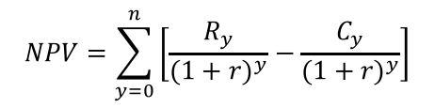
ຕົວຊີ້ວັດການລົງທືນ
1
ມູນຄ່າປະຈຸບັນສຸທິ
ມູນຄ່າປະຈຸບັນສຸທິ (NPV)
the discounted sum of all future revenues and costs to the present
ຄວາມເພີ່ງພໍໃຈຂອງນັກລົງທືນທີ່ພ້ອມຈະຈ່າຍ ຕໍ່ການລົງທ່ືນ (asset) ໂດຍອີງຕາມ ຜົນໄດ້ຮັບ, ລາຍຈ່າຍທີ່ຄາດໄວ້ ແລະ ອັດຕາຜົນຕອບແທນທີ່ຍອມຮັບໄດ້.
$$ສູດ:$$
$$NPV=\sum_{y=0}^{n}{\left[\frac{R_{y}}{{(1+r)}^{y}}−\frac{C_{y}}{{(1+r)}^{y}}\right]}$$
#4
ຊື່ງວ່າ:
R_{y} and C_{y} are revenues and costs in any year y.
Notes:
#3 The following equation is the formula of Net present value as discussed in the previous topic. NPV can be also described as the discounted sum of all future revenues and costs to the present. It defines the investor’s willingness to pay for an asset based on estimated benefits, costs, and the desired rate of return.

Slide 26
ຕົວຊີ້ວັດການລົງທືນ
1
ມູນຄ່າປະຈຸບັນສຸທິ
#3
#4
If the NPV greater than $0, accept the project
if the NPV is less than $0, reject the project.
#5
#5
the firm will earn a return greater than its cost of capital.
#6
#6
such action should increase the market value of the firm, and
therefore the wealth of its owners by an amount equal to the NPV.
Notes:
#3 If the NPV is greater than $0, accept the project. #4 If the NPV is less than $0, reject the project. In other words, If the NPV is greater than $0, the firm will earn a return greater than its cost of capital. #5 Such action should increase the market value of the firm, #6and therefore the wealth of its owners by an amount equal to the NPV.

Slide 27
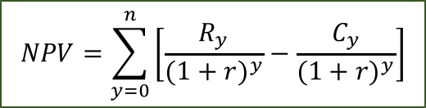
ຕົວຊີ້ວັດການລົງທືນ
1
ມູນຄ່າປະຈຸບັນສຸທິ
ຕາຕະລາງທີ 6.3.1 ເງີນໝູນວຽນຂອງ 2 ໂຄງການ (ດອກເບ້ຍ 7 ເປີເຊັນ)
ປີ | ເງີນໜູນວຽນ, ໂຄງການ A ($) | ເງີນໜູນວຽນ, ໂຄງການ B ($)
0 | -500 | -300
5 | -200 | -100
8 | - | 900
15 | 400 | -
30 | 7,700 | 3,500
ໂດຍນຳໃຊ້ສູດ NPV:
$$NPV=\sum_{y=0}^{n}{\left[\frac{R_{y}}{{(1+r)}^{y}}−\frac{C_{y}}{{(1+r)}^{y}}\right]}$$
ເພື່ອຄິດໄລ່ NPV ຂອງໂຄງການ A:
ຊື່ງ: r=7%,C0=-$500, C5=-$200; R15=$400; and R30=$7,700
$NPV(A)=\sum_{y=0}^{n}{\left[\frac{R_{y}}{{(1+r)}^{y}}−\frac{C_{y}}{{(1+r)}^{y}}\right]}$=$\frac{7,700}{{(1.07)}^{30}}+\frac{400}{{(1.07)}^{15}}−\frac{200}{{\left(1.07\right)}^{5}}−\frac{500}{{\left(1.07\right)}^{0}}≈\$514$
“ນີ້ກໍ່ໝາຍຄວາມວ່າ ນັກລົງທືນສາມາດຈ່າຍຮອດ $514 ອີກ ແລະ ຍັງສາມາດມີອັດຕາຜົນຕອບແທນ 7 %.”
Notes:
#3 Table 6.3.1 shows two example of forestry investment: Project A has more distant income than project B with nearer income. #3~1Project A yields timber harvests at 15 and 30 whilst #3~2Project B earns at age 8 and 30. We assume that the decision maker wishes to earn a7 percent real rate of return (MAR), #4by using the formula NPV, #5we can get NPV of Project A is approximately $514 and #6this means that the investor could pay up to $514 more and still earn a 7 percent rate of return.

Slide 28

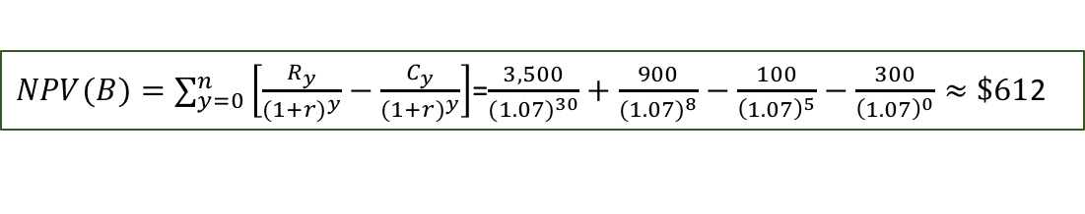
ຕົວຊີ້ວັດການລົງທືນ
1
ມູນຄ່າປະຈຸບັນສຸທິ
ຕາຕະລາງທີ 6.3.1 ເງີນໝູນວຽນຂອງ 2 ໂຄງການ (ດອກເບ້ຍ 7 ເປີເຊັນ)
#3
#3
ປີ | ເງີນໜູນວຽນ, ໂຄງການ A ($) | ເງີນໜູນວຽນ, ໂຄງການ B ($)
0 | -500 | -300
5 | -200 | -100
8 | - | 900
15 | 400 | -
30 | 7,700 | 3,500
ໂດຍນຳໃຊ້ສູດ NPV:
#4
$$NPV=\sum_{y=0}^{n}{\left[\frac{R_{y}}{{(1+r)}^{y}}−\frac{C_{y}}{{(1+r)}^{y}}\right]}$$
ເພື່ອຄິດໄລ່ NPV ຂອງໂຄງການ B:
ຊື່ງວ່າ: r=7%,C0=-$300, C0=-$ 100; C8=-$900; and R30=$7,700
#5
$NPV(B)=\sum_{y=0}^{n}{\left[\frac{R_{y}}{{(1+r)}^{y}}−\frac{C_{y}}{{(1+r)}^{y}}\right]}$=$\frac{3,500}{{(1.07)}^{30}}+\frac{900}{{(1.07)}^{8}}−\frac{100}{{\left(1.07\right)}^{5}}−\frac{300}{{\left(1.07\right)}^{0}}≈\$61$2
#6
“ນີ້ກໍ່ໝາຍຄວາມວ່າ ນັກລົງທືນສາມາດຈ່າຍຮອດ $612 ອີກ ແລະ ຍັງສາມາດມີອັດຕາຜົນຕອບແທນ 7 %.”
Notes:
#4by using the formula NPV, #5we can get NPV of Project B is approximately $612 and #6this means that the investor could pay up to $612 more and still earn a 7 per cent rate of return.

Slide 29
ຕົວຊີ້ວັດການລົງທືນ
1
ມູນຄ່າປະຈຸບັນສຸທິ
#3
ໂປຼແກມ ເອກແຊວ ສາມາດຖືກນຳໃຊ້ຄິດໄລ່ NPV ໂດຍນຳໃຊ້ NPV function, ຊື່ງມີພາສາຂອງສູດດັ່ງນີ້:
=NPV (discount rate, range of amounts from year 1 onwards) + Initial cost (i.e. year o amount)
ຕົວຢ່າງ
ຈົ່ງຄິດໄລ NPV ຂອງໂຄງການ A,B,C & D. ອັດຕາດອກເບ້ຍ 11 ເປີເຊັນ :
 | A | B | C | D | E
1 | ດອກເບ້ຍ= | 11%
2 | ປີ | ໂຄງການ A | ໂຄງການ B | ໂຄງການ C | ໂຄງການ D
3 | 0 | -5,000 | -5,000 | -5,000 | -5,000
4 | 1 | 325 | 325 | 325 | 325
5 | 2 | 325 | 200 | 75 | -50
6 | 3 | 875 | 3,000 | 4,000 | 7,375
7 | 4 | 1,287.5 | 5,000 | 8,000 | 12,850
8 | 5 | 1,700 | 6,000 | 10,000 | 18,325
9 | 6 | 2,000 | 8,000 | 5,000 | 23,800
10 | NPV (Function) | =NPV($B$1,B4:B9)+B3 | =NPV($B$1,C4:C9)+C3 | =NPV($B$1,D4:D9)+D3 | =NPV($B$1,E4:E9)+E3
11 | NPV= | ($877) | $8,780 | $12,156 | $32,709
Number of column in Ms. Excel sheet
#5
#6
Notes:
#3 For convenience, Microsoft Excel can be used to calculate the NPV with its NPV function, the general syntax of which is =NPV (discount rate, range of amounts from year 1 onwards) + Initial cost (i.e. year o amount).
#4Table 6.3.1 shows cash flows for four different projects (the discount rate is 11 percent) namely: Project A, B, C and D. #5By using the formula from the spreadsheet from Microsoft Excel, #6By we can easily calculate the NPV for all four projects. From the calculation, we know that Project D has the highest value of NPV.

Slide 30
ຕົວຊີ້ວັດການລົງທືນ
2
ການວິເຄາະລາຍຮັບຕໍ່ລາຍຈ່າຍ
ການວິເຄາະລາຍຮັບ
ຕໍ່ລາຍຈ່າຍ
(BCA)
An economic tool for the analysis of the benefits and costs.
May be either monetary or non-monetary value
Projects/policies
#4
may have negative environmental effects, i.e. negative externalities
may have positive externalities
may have both positive and negative externalities
“For these reason, these externalities should be taken into account in order to correct for any potential market failure.”
#5
Notes:
#2 Benefit-Cost analysis
#3Benefit Cost Analysis is an economic tool for the analysis of benefits and costs. It has been widely used to examine government policy and investment project analysis.
Furthermore, the Benefit Cost Analysis can take into account environmental impacts of policies or projects. #4For instance, the investment project or the government policies perhaps have negative externalities, and sometimes, It may have positive externalities. In other cases, it may have both negative externalities and positive externalities. #5 For these reason, these externalities should be taken into account in order to correct for any potential market failure.

Slide 31

ຕົວຊີ້ວັດການລົງທືນ
2
ການວິເຄາະລາຍຮັບຕໍ່ລາຍຈ່າຍ
ການວິເຄາະລາຍຮັບ
ຕໍ່ລາຍຈ່າຍ
(BCA)
the ratio of the sum of the project’s discounted benefits to the sum of its discounted costs.
$$Formula:$$
#4
6.5
Where:
R_{y} and C_{y} are revenues and costs in any year y.
#5
#6
If the B/C is greater than 1, accept the project
if the B/C is less than 1, reject the project.
Notes:
#3 Benefit-Cost ratio (B/C) is the ratio of the sum of the project’s discounted benefits to the sum of its discounted costs. #4 The formula can be written as specified in equation 6.5 ; Where Ry and Cy are revenues and costs in any year y.
#5 Decision criteria:
If the B/C is greater than 1, we accept the project.
#6If the B/C is less than 1, we reject the project.

Slide 32
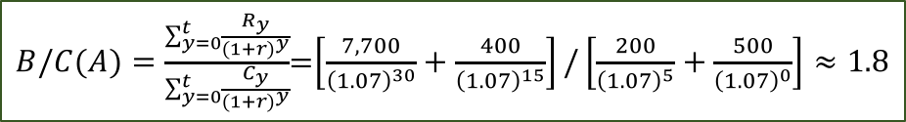
ຕົວຊີ້ວັດການລົງທືນ
2
ການວິເຄາະລາຍຮັບຕໍ່ລາຍຈ່າຍ
ຕາຕະລາງທີ 6.3.1 ເງີນໝູນວຽນຂອງ 2 ໂຄງການ (ດອກເບ້ຍ 7 ເປີເຊັນ)
ປີ | ເງີນໜູນວຽນ, ໂຄງການ A ($) | ເງີນໜູນວຽນ, ໂຄງການ B ($)
0 | -500 | -300
5 | -200 | -100
8 | - | 900
15 | 400 | -
30 | 7,700 | 3,500
ໂດຍນຳໃຊ້ສູດ B/C:
ເພື່ອຄິດໄລ່ B/C ຂອງໂຄງການ A:
ຊື່ງວ່າ: r=7%,C0=-$500, C5=-$200; R15=$400; and R30=$7,700
$B/C(A)=\frac{\sum_{y=0}^{t}{\frac{R_{y}}{{(1+r)}^{y}}}}{\sum_{y=0}^{t}{\frac{C_{y}}{{(1+r)}^{y}}}}$=$\left[\frac{7,700}{{\left(1.07\right)}^{30}}+\frac{400}{{\left(1.07\right)}^{15}}\right]/\left[\frac{200}{{\left(1.07\right)}^{5}}+\frac{500}{{\left(1.07\right)}^{0}}\right]≈1.8$
“ໝາຍຄວາມວ່າ ພວກເຮົາຄວນຈະຍອມຮັບ ແລະ ລົງທືນໂຄງການ A.”
Notes:
#3 The next step, we are going to use the same data from the previous exercise. As mentioned earlier, Project A has more distant income than project B with nearer income. #3~1 Project A yields timber harvests at 15 and 30 #3~2whilst Project B earns at age 8 and 30. #4 By using the formula of the Benefit-Cost ratio, #5 we can find that the Benefit-Cost ratio of Project A is approximately 1.8, #6which implies that we should go ahead with the project A

Slide 33
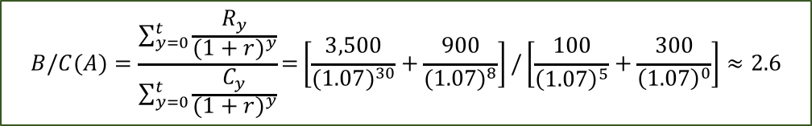
ຕົວຊີ້ວັດການລົງທືນ
2
ການວິເຄາະລາຍຮັບຕໍ່ລາຍຈ່າຍ
ຕາຕະລາງທີ 6.3.2 ເງີນໝູນວຽນຂອງ 2 ໂຄງການ (ດອກເບ້ຍ 7 ເປີເຊັນ)
#3
ປີ | ເງີນໜູນວຽນ, ໂຄງການ A ($) | ເງີນໜູນວຽນ, ໂຄງການ B ($)
0 | -500 | -300
5 | -200 | -100
8 | - | 900
15 | 400 | -
30 | 7,700 | 3,500
ໂດຍນຳໃຊ້ສູດ B/C:
#4
ເພື່ອຄິດໄລ່ B/C ຂອງໂຄງການ B:
ຊື່ງວ່າ: r=7%,C0=-$300, C0=-$ 100; C8=-$900; and R30=$7,700
$$B/C(A)=\frac{\sum_{y=0}^{t}{\frac{R_{y}}{{(1+r)}^{y}}}}{\sum_{y=0}^{t}{\frac{C_{y}}{{(1+r)}^{y}}}}\text{=}\left[\frac{3,500}{{(1.07)}^{30}}+\frac{900}{{(1.07)}^{8}}\right]/\left[\frac{100}{{\left(1.07\right)}^{5}}+\frac{300}{{\left(1.07\right)}^{0}}\right]≈2.6$$
#5
Notes:
#4 Similarly, by using the same formula as the calculation of the project A, #5 we find that the Benefit-Cost ratio of project B is appro. 2.6.

Slide 34
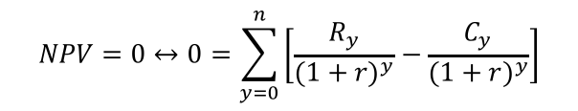
ຕົວຊີ້ວັດການລົງທືນ
3
ອັດຕາຜົນຕອບແທນພາຍໃນ (IRR)
ອັດຕາຜົນຕອບແທນພາຍໃນ (IRR)
The discount rate which sets the NPV of all cash flows equal to 0.
IRR is unique or internal to a project.
It is the rate of return earned on funds invested in a project.
$$ສູດ:$$
$$NPV=0↔0=\sum_{y=0}^{n}{\left[\frac{R_{y}}{{(1+r)}^{y}}−\frac{C_{y}}{{(1+r)}^{y}}\right]}$$
#4
6.6
#5
#6
ຖ້າວ່າ IRR > ລາຍຈ່າຍຂອງຕົ້ນທືນ, ຍອມຮັບໂຄງການ
ຖ້າວ່າ IRR < ລາຍຈ່າຍຂອງຕົ້ນທືນ, ປະຕິເສດໂຄງການ
#7
“These criteria guarantee that the project will earn at least its required return. “
Notes:
#3 Another common criterion for assessing the investment is the internal rate of return (IRR). #4As can be seen in equation 6.6, the IRR of a project is the discount rate at which the present value of revenues equals the present value of costs. In the practical analysis, we can use spreadsheet programs or any modern business calculators. Decision criteria:
#5 If the IRR is greater than the cost of capital, we accept the project.
#6 If the IRR is less than the cost of capital, we reject the project.
#7 These criteria guarantee that the project will earn at least its required return.

Slide 35
ຕົວຊີ້ວັດການລົງທືນ
3
ອັດຕາຜົນຕອບແທນພາຍໃນ (IRR)
#3
ໂປຼແກມ ເອກແຊວ ສາມາດຖືກນຳໃຊ້ຄິດໄລ່ IRR ໂດຍນຳໃຊ້ IRR function, ຊື່ງມີພາສາຂອງສູດດັ່ງນີ້:
=IRR (range of amounts from year 1 onwards)
#4
ຕົວຢ່າງ
ຈົ່ງຄິດໄລ IRR ຂອງໂຄງການ A,B,C & D. ອັດຕາດອກເບ້ຍ 11 ເປີເຊັນ :
 | A | B | C | D | E
1 | ປີ | ໂຄງການ A | ໂຄງການ B | ໂຄງການ C | ໂຄງການ D
2 | 0 | -5,000 | -5,000 | -5,000 | -5,000
3 | 1 | 325 | 325 | 325 | 325
4 | 2 | 325 | 200 | 75 | -50
5 | 3 | 875 | 3,000 | 4,000 | 7,375
6 | 4 | 1,287.5 | 5,000 | 8,000 | 12,850
7 | 5 | 1,700 | 6,000 | 10,000 | 18,325
8 | 6 | 2,000 | 8,000 | 5,000 | 23,800
9 | IRR (Function) | =IRR(B2:B8) | =IRR(C2:C8) | =IRR(D2:D8) | =IRR(E2:E8)
10 | IRR= | 6% | 39% | 48% | 74%
Number of column in Ms. Excel sheet
#5
#6
Notes:
#4 Table 6.3.3 shows cash flows for four different projects (the discount rate is 11 percent) namely: Project A, B, C and D. #5 By using the formula from the spreadsheet from Microsoft Excel, #6 we can simply calculate the IRR for all four projects. From the calculation, our project choice is project D which has the highest IRR value.

Slide 36
04: ກໍລະນີສຶກສາ ການວິເຄາະການລົງທືນສວນປູກ
Case example 01 and solution

Slide 37
ກໍລະນີສຶກສາ ການວິເຄາະການລົງທືນສວນປູກ
1
ກໍລະນີສຶກສາທີ 01
For instance, consider a Forestry Agency that has just planted an area of land with 100,000 samplings at a cost of $11 per tree, $1 of which was planting costs (the remainder being purchase cost). The trees will be ready for felling after 10 years at the earliest, and during the maturing period grow at an annual compound rate such that the value of usable wood increases each year by 20% of the initial purchase cost of each tree.
During the maturing period the annual cost of tending the plantation is expected to be equal to 1.5% of the value of the plantation at the start of that year, payable at the start of the second and all subsequent years. (The first year’s tending costs are included in the planting cost at the start of the first year).
Using an 8% discount rate, calculate the NPV and the IRR of this investment if the Forestry Agency decides that all of the trees are to be felled as soon as they mature, and if the cost of this felling is 5% of the value of trees felled.
Notes:
#3 For example, consider a Forestry Agency that has just planted an area of land with 100,000 samplings at a cost of $11 per tree, $1 of which was planting costs (the remainder being purchase cost). The trees will be ready for felling after 10 years at the earliest, and during the maturing period grow at an annual compound rate such that the value of usable wood increases each year by 20% of the initial purchase cost of each tree.
During the maturing period the annual cost of tending the plantation is expected to be equal to 1.5% of the value of the plantation at the start of that year, payable at the start of the second and all subsequent years. (The first year’s tending costs are included in the planting cost at the start of the first year).
Using an 8% discount rate, calculate the NPV and the IRR of this investment if the Forestry Agency decides that all of the trees are to be felled as soon as they mature, and if the cost of this felling is 5% of the value of threes felled.

Slide 38
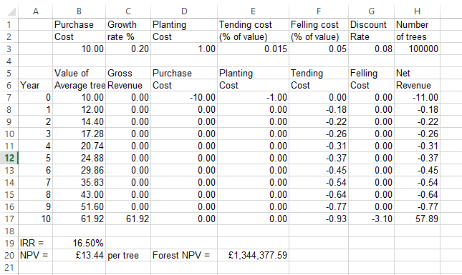
ກໍລະນີສຶກສາ ການວິເຄາະການລົງທືນສວນປູກ
2
ຕອບກໍລະນີສຶກສາທີ 01
=$E$3*B8
V=10(1.2)¹⁰=£61.92
The purchase cost in year 0 = £10
Planting cost = £1 in year 0
In F8: =-$E$3*B8
In G17:=-$F$3*B17
H7:=SUM(C7:G7).
In B19:=IRR(H7:H17,0.1) and this give returns a value of 16.5%.
In B20: =NPV(G3,H8:H17)+H7
To calculate NPV for the whole forest, in E20: =B20*H3
Therefore, the project is viable at the 8% discount rate.
In socio-economic farm research
#4~1
V=10(1.2)¹⁰
Source: Whigham D. (2001).

Slide 39
ຝືກຫັດ 1
Let’s do the quick pre-test about your experience! Please choose the only one right answer!
!
Please solve NPV for this project (interest rate of 11 percent) based on data below:
99.91
1
258.21
2
-198.73
3
4
220.05
Notes:
$$NPV(A)=\sum_{y=0}^{n}{\left[\frac{R_{y}}{{(1+r)}^{y}}−\frac{C_{y}}{{(1+r)}^{y}}\right]}$$
$NPV(A)$=$\frac{7700}{{(1.11)}^{30}}+\frac{400}{{(1.11)}^{15}}−\frac{200}{{\left(1.11\right)}^{5}}−500≈−\$\text{198.73}$

Slide 40
ຝືກຫັດ 2
Let’s do the quick pre-test about your experience! Please choose the only one right answer!
!
Please solve B/C for the following project(interest rate of 11 percent) based on data below:
2.0
1
0.9
2
1.5
3
4
0.68
Notes:
$B/C(A)=\frac{\sum_{y=0}^{t}{\frac{R_{y}}{{(1+r)}^{y}}}}{\sum_{y=0}^{t}{\frac{C_{y}}{{(1+r)}^{y}}}}$=$\left[\frac{7700}{{\left(1.11\right)}^{30}}+\frac{400}{{\left(1.11\right)}^{15}}\right]/\left[\frac{200}{{\left(1.11\right)}^{5}}−500\right]≈0.68$

Slide 41
!
#2
Let’s take a quiz to review what we learn ……by answer the question as show in screen
Based on data below, IRR will be 15%
1
True
False
Notes:
Commentary: The answer is False, IRR=13%

Slide 42
References:
Phimmavong, S. (2012). Forest plantation development, poverty, and inequality in Laos: a CGE microsimulation
analysis. The University of Melbourne, Melbourne.
Whigham D. (2001). Managerial Economics using Excel. Cengage Learning EMEA; 1 edition (March 8, 2001)
W. David Klemperer. (1996,2003). Forest resource economics and finance. New York: McGraw Hill.

